Slide 1
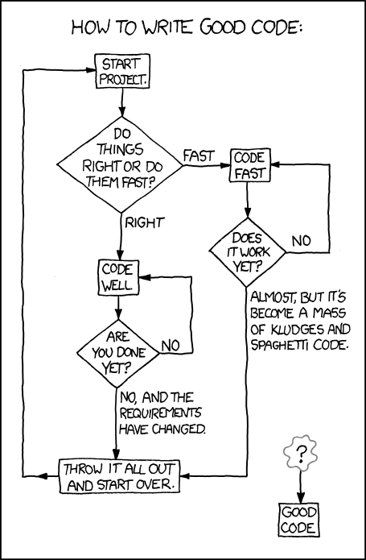
Testing I
Andrew Hu

Slide 2
Administrivia
Attendance: http://tinyurl.com/uwigem/18sp/attendance/
Spec meetings
Adjust spec based on feedback
Go implement!
Have until next week, since the deadline was extended

Slide 3
Aside: When will we work on a real project?
Start low-risk
Experience we gain from practice/“toy projects”
Code collaboration
Teamwork
Software
We will start working as a team after Pacman and the EE lab has been completed ☺

Slide 4
Agenda
How to get good code
Unit Testing
Project Meeting

Slide 5
How to avoid bugs?
Use a language with types (like Java)
Test your code
These 3 things prevent >90% of all bugs
Ask other people to look at your code

Slide 6
How to write a simple test?
Call a method with one set of input
result = o.mapOnto(input);
if(result != expected){
print(“mapOnto() failed with ”+result);
}

Slide 7
What happens when a test fails?
You go look inside the code, but your method calls several other methods
What is causing the problem?
Your code?
The methods you are calling?
void mapOnto(int[] input){
for(int i : input){
input += i;
}
this.updateFields();
}

Slide 8
Unit test
Fix this by making sure that every single method has its own test
Unit tests build on top of each other
When every method called inside another method is tested, we know where the problem is

Slide 9
Unit Tests
void mapOnto(int[] input){
for(int i : input){
input += i;
}
this.updateFields();
}
void tests(){
testUpdateFields();
//^^This passes
testMapOnto();
//^^This fails
/*Which part of mapOnto
is causing a problem?*/
}

Slide 10
How to test an entire system?
Testing a video game?
Testing a utility, like Word?
Write internal tests that chain together multiple methods?
Have a person try to use the software?

Slide 11
Integration test
Multiple method calls one after another
Then verify that the state is as expected

Slide 12
System Testing
Have a human use the system
Write down if anything weird happens
Often called “play testing” in video game development

Slide 13
Remember Pre & Postconditions?
Author assumes the precondition is true when the method is called
User assumes the postcondition is true after the method is called
Some things often show up as both pre and postconditions

Slide 14
Invariant
If something is true before and after every method call it is invariant
E.g.
The array field is never null
The sum field always represents the sum of the elements in the array
Since these things relate to the representation of your data, it is called the representation invariants

Slide 15
Check Rep
The representation invariant should never be false
We can just call a method to check that the invariant is true, at the end of every method
This is the “check rep”

Slide 16
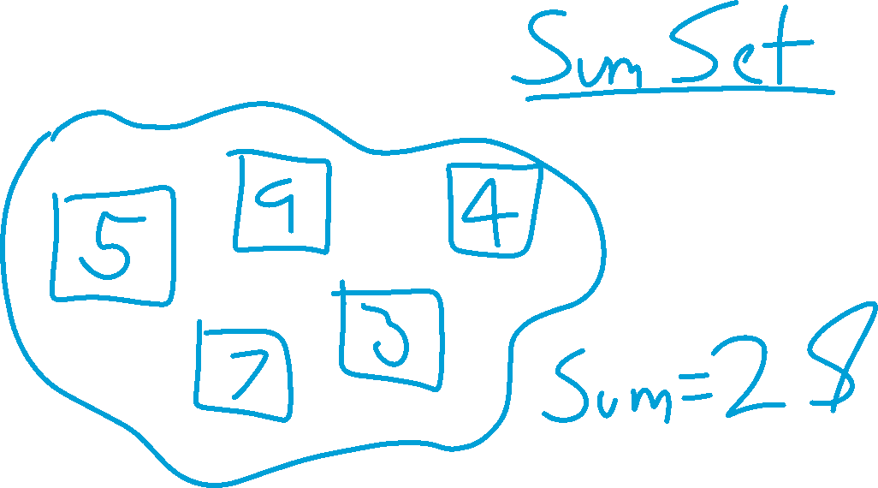
Toy Example

Slide 17
“Sum Set” Example
We want to do two operations: add to the set, and get the sum
Example implementation:
class SumSet {
private List<Integer> nums;
public void add(int i) {
nums.add(i);
}
public int sum();
}

Slide 18
SumSet Sum Method
How to efficiently return the sum? (the simple answer please ☺)
class SumSet {
private List<Integer> nums;
public void add(int i) {
nums.add(i);
}
public int sum() {
// What goes here?
}
}

Slide 19

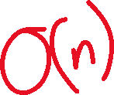
SumSet Sum Method
class SumSet {
private List<Integer> nums;
public void add(int i) {
nums.add(i);
}
public int sum() {
int result = 0;
for (int i : nums) {
result += i;
}
return result;
}
}

Slide 20
SumSet Sum Method
SumSet s = new Sumset();
// Add some elements
for(int i=0;i<10;i++){
s.add(i);
}
// Print the sum
print(s.sum());
// Print the same sum
print(s.sum());
class SumSet {
private List<Integer> nums;
public void add(int i) {
nums.add(i);
}
public int sum() {
int result = 0;
for (int i : nums) {
result += i;
}
return result;
}
}

Slide 21
“Memo-ization”
Use “memo-ization” to return the sum this efficiently
After traversing the list, save the sum into a variable (currSum)
As long as nothing is added, our sum is still added
When we add another int, recalculate the sum

Slide 22
SumSet Sum Method
class SumSet {
private List<Integer> nums;
private int currSum;
public void add(int i) {
nums.add(i);
calcSum();
}
public void calcSum() {
currSum = 0;
for (int i : nums) {
currSum += i;
}
}
public int sum() {
return currSum;
}
}
SumSet s = new SumSet();
// Add some elements
for(int i=0;i<10;i++){
s.add(i);
}
// Print the sum: O(n)
print(s.sum());
// Print the sum: O(1)
print(s.sum());

Slide 23
SumSet Representation Invariants
Two things are always true about the SumSet
The list (nums) is never null
currSum is always equal to the sum of all the elements

Slide 24
SumSet Check Rep
Have a method called checkRep() that checks that these two things are true after every method call

Slide 25
Coverage testing
How do we know that we’ve actually tested all of our code?
Not just all the methods, but all the possible different inputs
Coverage testing tells you how many times each line was run after a series of tests

